Slide 1
Session 1
Creating R API services
25 Mar 2019

Slide 2
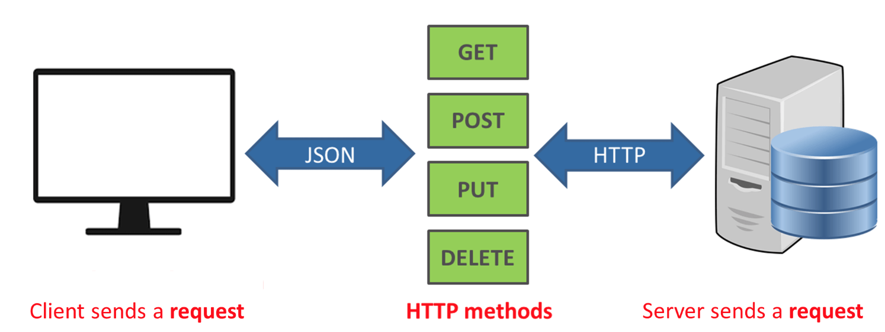
What is an API?
REST API is an architecture style for designing networked applications
* API economy is the exposure of an organization's digital services and assets through application programming interfaces (APIs) in a controlled way.

Slide 3
Basic Setup
Convert R models to API
Operationalized R
Docker Image
Notebooks
API
Apps
API
Model Testing
model.rds
API
plumber
Data Integration
plumber
plumber
train
serve
train
serve
train.R
predict.R
Linux + R Base Image
Linux + R Base Image
entrypoint
EC2 Instance
train
serve
main.R
Dockerfile
RStudio
Docker
AWS

Slide 4

Demo
How to convert R model to API-based docker image using plumber

Slide 5
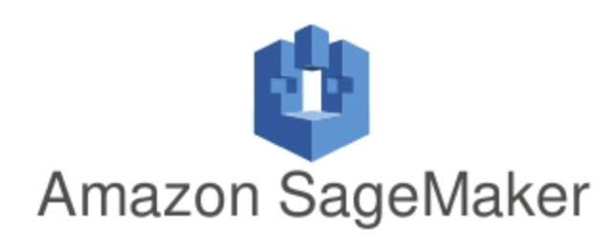
AWS Deployment Using SageMaker
https://docs.aws.amazon.com/sagemaker/latest/dg/your-algorithms.html*
* Make sure that your docker image complies with SageMaker standard configuration

Slide 6
AWS Deployment Using SageMaker

Slide 7
AWS Deployment Using SageMaker
Suitable for EDC Operationalization Needs
=
R Model
Docker Image

Slide 8
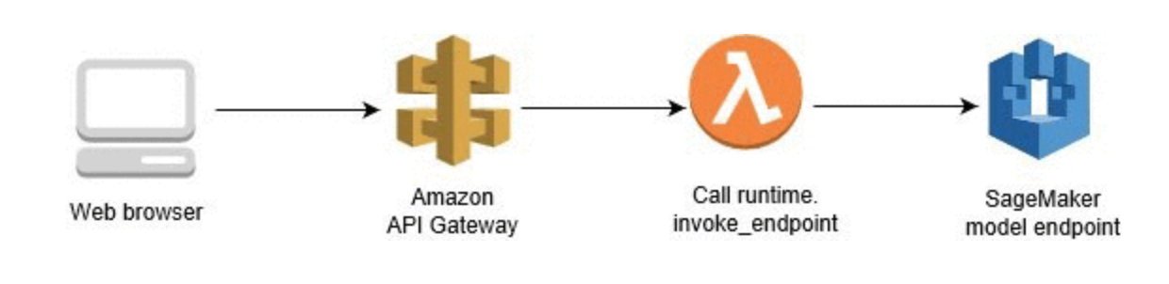
Demo
Using SageMaker to Expose Inference API Securely

Slide 9
Advanced Architecture
R Model

Slide 10
Reference
Code and Slides are available on Github
https://github.com/jafaeldon/r-api-demo

Slide 11
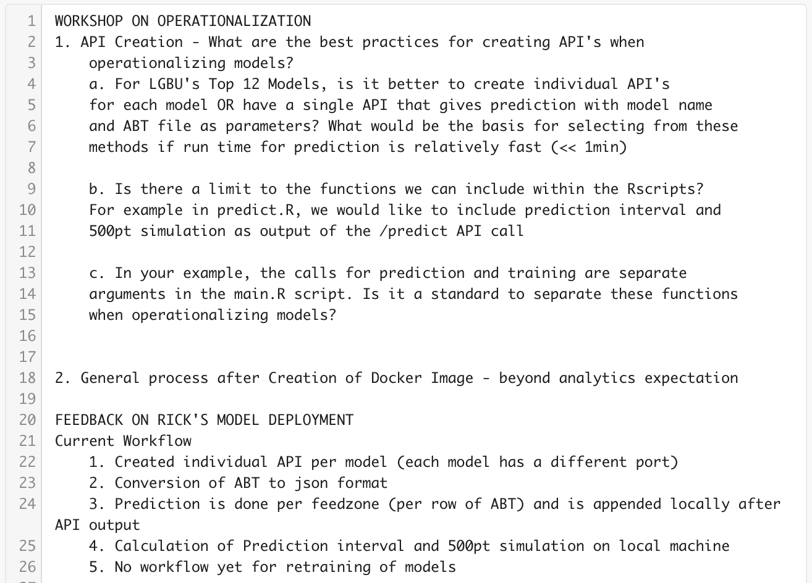
Questions

Slide 12
Session 2
AWS Admin and Deployment
2 Apr 2019

Slide 13
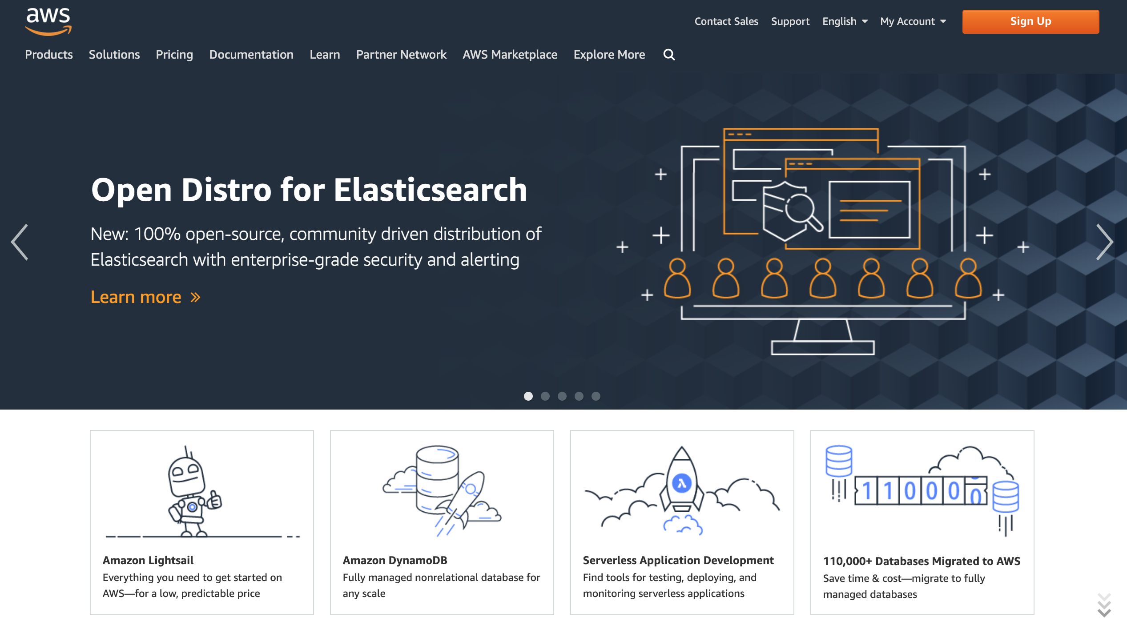
Demo
Provisioning Servers on AWS
https://919754311132.signin.aws.amazon.com/console

Slide 14
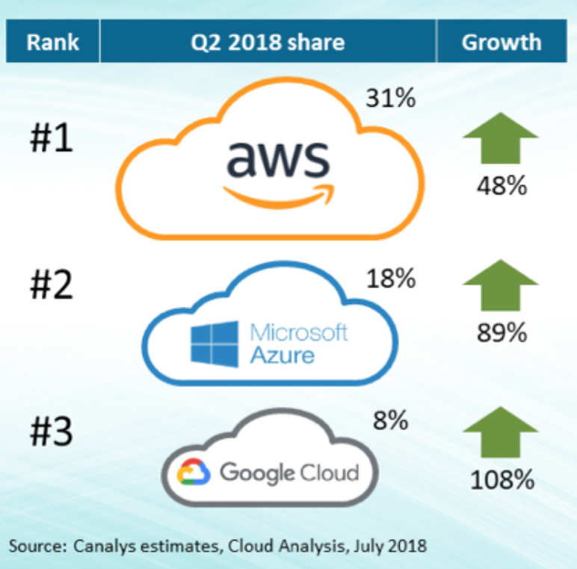
Amazon Web Services
Infrastructure as a Service (IaaS)
Pay as you go/use
Public Cloud
Self-service

Slide 15
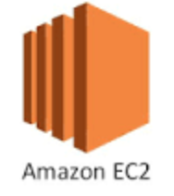
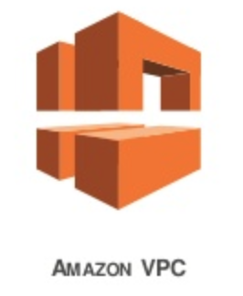

Common Services
Basic building blocks of AWS
Servers + Local Storage (SSD/HD)
Networking + Security
Cheaper (no server to host files)
Shared Storage
API Access
Data Lake
++
Object Storage

Slide 16
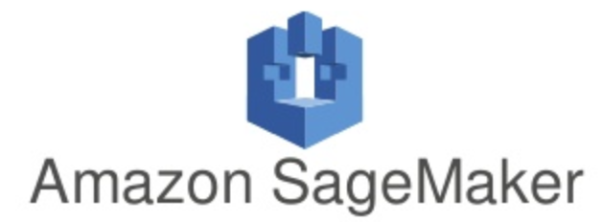
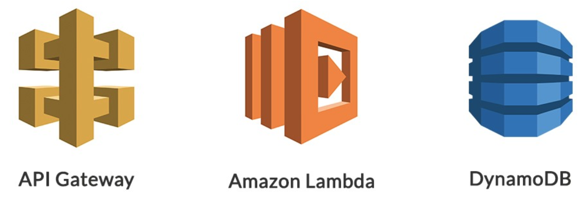
Pricing
Used By
$
Free (no per user charging)
$
$

Slide 17

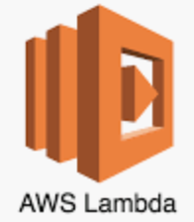



Z-Lift Project Sample Services
May vary depending on requirements
Operationalized
Analytical Model
Full Lifecycle Analytical Model
DWH + BI

Slide 18
Full-Blown Architecture

Slide 19
Or Just Use EC2
Start with the basic EC2 setup and add services as needed
+
+
SQL Server
Docker Image
+
+
R Server
Custom Code
+
Tableau Server

Slide 20
Demo
Signing Up
EC2 Provisioning
Logging in the server (ssh/putty) – Linux AMI
Logging in the server (rdp) – Windows Server
Github + Docker Demo (cont. of session 1)

Slide 21


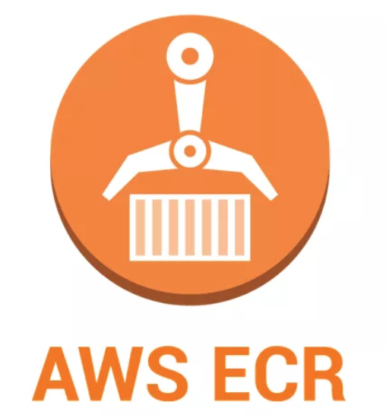


Docker Deployment Workflow
1. Push Code*
Dockerfile
2. Pull Code*
4. Docker Push
3. Docker Build
6. Docker Pull
8. Test API
7. Docker Run
* Or you can zip the project file and send

Slide 22
Session 3
Microsoft Machine Learning Service
2 Apr 2019

Slide 23
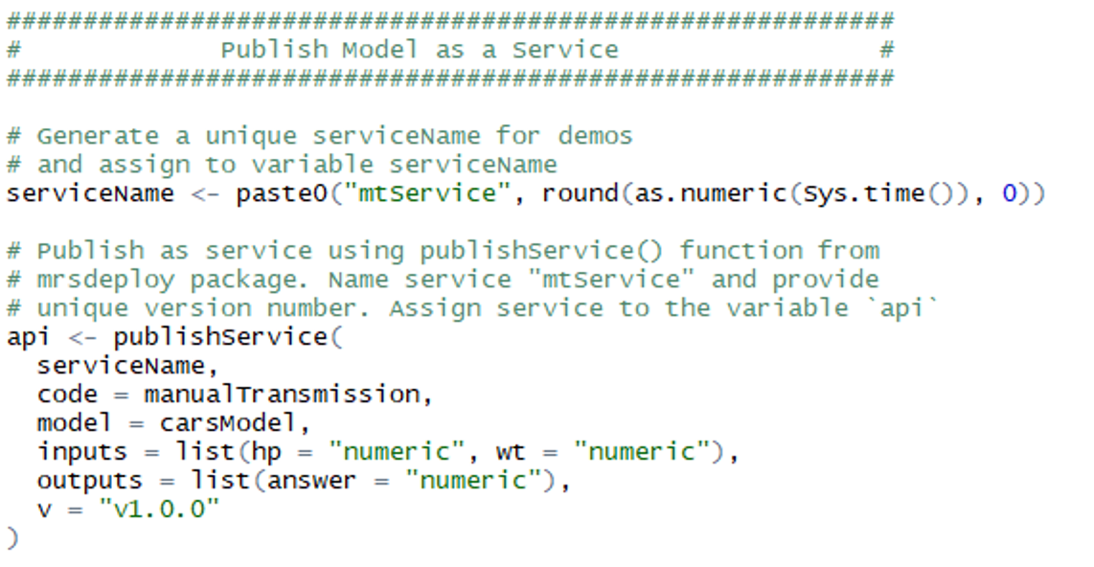
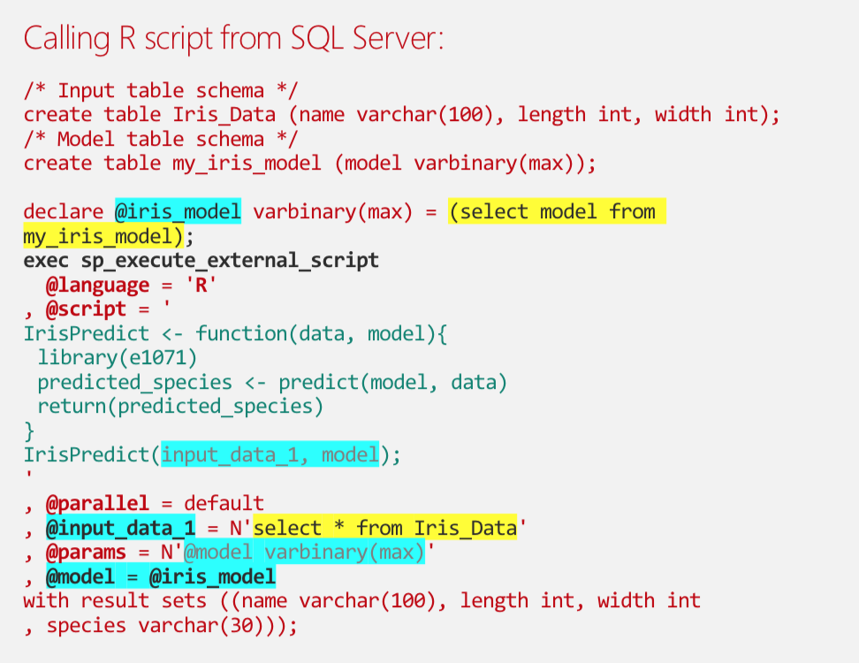
Microsoft R Support
Both has RevoScaleR, runs Microsoft R and can be installed using SQL Server 2017
Machine Learning Server
R script In-Database
Operationalized via API
Operationalized via SQL

Slide 24
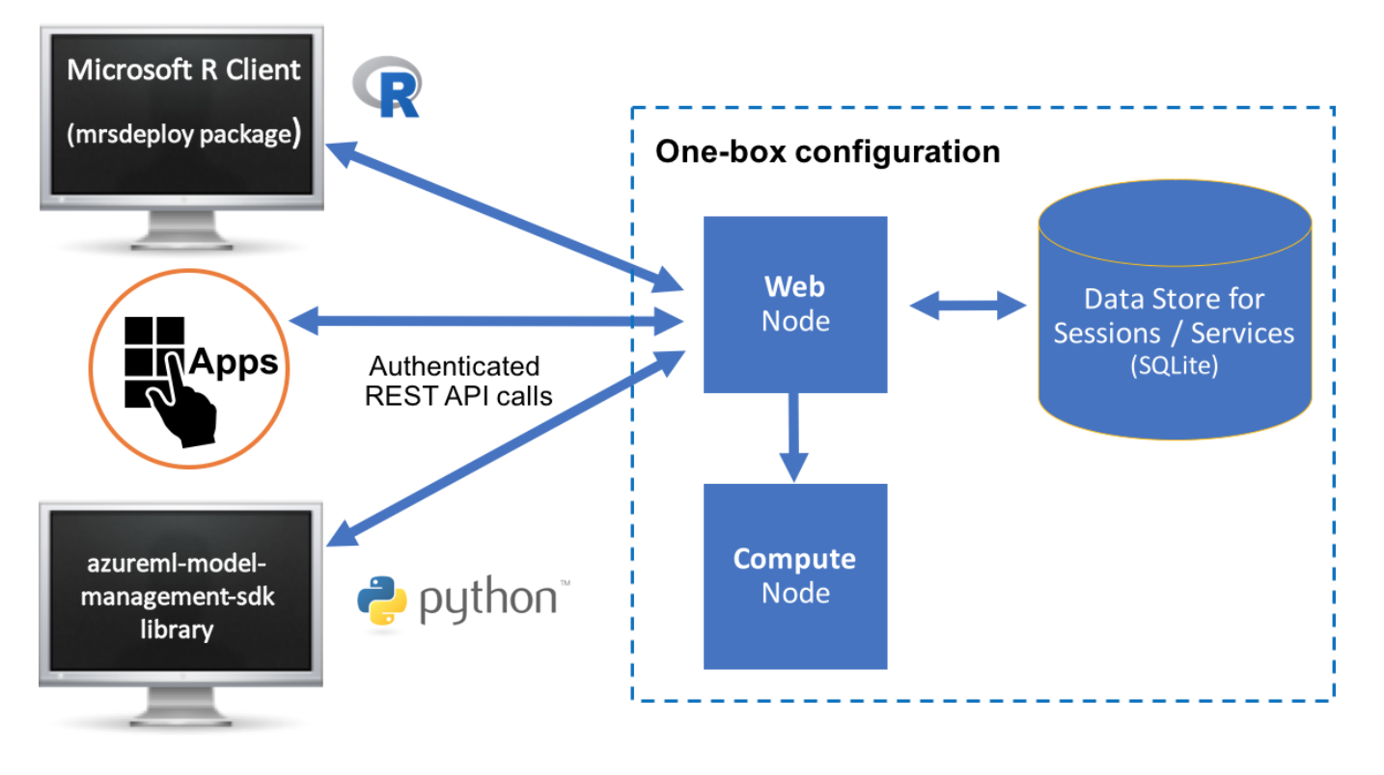
Demo R API on MS Machine Learning Server

Slide 25
Installation and Publishing R API
Part 1: Setup SQL Server with Machine Learning Server
https://docs.microsoft.com/en-us/sql/advanced-analytics/install/sql-machine-learning-standalone-windows-install?view=sql-server-2017
Install Windows Server 2019 on AWS
Download and install SQL Server 2017 using Remote Desktop
Install ML Services
Run RGUI to test
Run Machine Learning Admin Util to setup one-box setup
Part 2: Setup Dev Workstation
Install Rclient
Install and Configure RStudio
Configure R Client under Tools-> Global Options -> General (to point to your R client installation)
Part 3: Publish R API
https://docs.microsoft.com/en-us/machine-learning-server/operationalize/quickstart-publish-r-web-service

Slide 26
How to choose between deployment options?
For Datamart + BI Projects on Cloud
For simple projects use AWS EC2 instances to run Datamart (ex. EC2 + MySQL or EC2 + MS SQL)
AWS RDS for fully-managed database setups (ex. daily snapshots + restore + HA)
For large-scale DWH consider Redshift
AWS EC2 instances to run hosted BI servers as BYOL (ex. Tableau Server, PowerBI Server)
Setup should be similar for Azure or GCP if client prefers
Fully-hosted BI for small projects only

Slide 27
How to choose between deployment options?
For Operationalizing R Models
For operationalizing model prediction step
This means you need to convert your R code to API
Prefer using plumber + docker approach as this is more platform agnostic (avoid vendor lock-in)
Use Microsoft Machine Learning Server if client is on Microsoft stack
For operationalizing model training step
On AWS best to use SageMaker for end-to-end model management; Use docker images to deploy custom R models
If not on SageMaker you can deploy docker image on EC2 and have a cron script/scheduler to docker run the model

Slide 28
FAQ
How about data prep and results?
For operationalized model training, assume data is readily available on local disk
If data prep is simple enough you can do it in R and make it as part of model training step
Use S3 as datalake and use Glue/EMR to do data transformation to and from S3
Allow SageMaker to automatically transfer files from datalake to and from the model
You can also manually transfer data also using AWS CLI s3 commands and use shell scripts
When do I use SparkR, RevoScaleR and In-Database R?
Low-latency requirements (response time < 1s)
Model training takes days need to reduce to minutes
How do I batch inference?
SageMaker can do batch
Manually you call the API multiple times using multiple data
How do I secure my API?
Use AWS API Gateway to proxy your calls to the service
How do I scale my API?
With a docker image you can do horizontal scaling via ECS and a load balancer

Slide 29
References
https://docs.aws.amazon.com/
https://docs.microsoft.com/en-us/machine-learning-server/

Slide 30

Thank You

